Slide 1

Temporal Analysis of News Sentiment and Topics Using Advanced NLP Techniques
University of Missouri-Kansas City TEAM: TOPIC THROVE Likhitha Naguluri
Samyuktha Vankadari
Lohitha Regalla
Pravigna Pala

Slide 2
Introduction
In this project, we analyze textual data to extract meaningful insights through sentiment analysis and topic modeling. Leveraging datasets in Parquet format, we focus on efficient preprocessing, analyzing sentiments using VADER, and exploring themes in the data using advanced models like BERTopic, LDA, and NMF. This study provides a comprehensive workflow for understanding large-scale text data, from cleaning and processing to modeling and interpretation.

Slide 3
Objectives
To process and analyze a dataset containing text data, focusing on cleaning, sentiment analysis, and topic extraction. The ultimate goal is to derive meaningful insights about the sentiments and topics present in the text. The dataset consists of textual content stored in Parquet files. These files were processed to extract information about sentiment polarity (positive, negative, neutral) and identify prominent themes using advanced NLP techniques.

Slide 4
Methodology
Data Loading and Exploration:
The dataset was imported from Parquet files, enabling efficient storage and faster data handling.
Initial exploration involved understanding the data structure, dimensions, and column types.
Unnecessary columns (e.g., redundant or irrelevant features) were removed to focus on key textual attributes.
Text Standardization:
Text data was standardized through:
Lowercasing all entries.
Removing punctuation, numbers, and stop words.
Tokenizing text to prepare it for advanced modeling.
These steps ensured a clean and consistent dataset ready for analysis.
Sentiment Analysis:
The VADER Sentiment Analyzer was utilized to compute sentiment scores across positive, negative, and neutral categories.
In Part 2, parallel processing techniques were applied to enhance performance when analyzing larger datasets, significantly reducing computational time.
Topic Modeling:
BERTopic:
Deployed for unsupervised dynamic topic extraction, providing semantically coherent and visually interpretable themes.
Traditional Methods:
TF-IDF vectorization captured significant textual features for subsequent modeling.
Latent Dirichlet Allocation (LDA) and Non-negative Matrix Factorization (NMF) were applied to identify and interpret thematic structures.
Evaluation:
Coherence scores were calculated to ensure the quality and interpretability of extracted topics.
Data Storage and Export:
All processed datasets, including sentiment-analyzed and topic-modeled results, were saved as Parquet files for easy accessibility and further analysis.
These files allow for seamless sharing and integration into downstream workflows.

Slide 5
Key Challenges
Data Quality: Addressing missing values and ensuring consistent preprocessing without losing important information.
Text Standardization: Balancing noise removal with retaining meaningful context in text data.
Sentiment Analysis: VADER's limitations with nuanced expressions like sarcasm and mixed sentiments.
Topic Modeling: Selecting optimal parameters and ensuring coherence of extracted topics across models.
Computational Efficiency: Managing memory and processing demands for large datasets, especially during parallelization.
Evaluation: Aligning quantitative metrics like coherence scores with qualitative interpretability.
Data Export: Maintaining compatibility and integrity of saved Parquet files for downstream use.

Slide 6
Results
Sentiment Analysis Results:
Text entries were classified into positive, negative, and neutral sentiments using VADER.
The dataset exhibited a higher proportion of neutral sentiments, suggesting a balanced or less emotionally charged tone in the content.
Positive and negative sentiments were distributed across specific themes, highlighting the diversity of perspectives within the data.
Topic Modeling Results:
BERTopic:
Identified key themes such as customer feedback, emerging trends, and operational insights.
The most prominent topics included:
Topic A: Discussions around user experience and satisfaction.
Topic B: Insights into market trends and innovations.
NMF and LDA:
Provided clear thematic separation with top terms aligning with distinct topics.
Coherence scores confirmed the interpretability and validity of the extracted topics.
Efficiency Gains:
Text standardization streamlined preprocessing, reducing noise and ensuring consistency in the dataset.
Analysis pipelines were enhanced through parallel processing, significantly improving computational efficiency.
Advanced NLP models, including TF-IDF and BERTopic, facilitated deeper insights while maintaining scalability.
Final datasets, enriched with sentiment and topic information, were exported for further applications such as business decision-making or in-depth analysis.

Slide 7
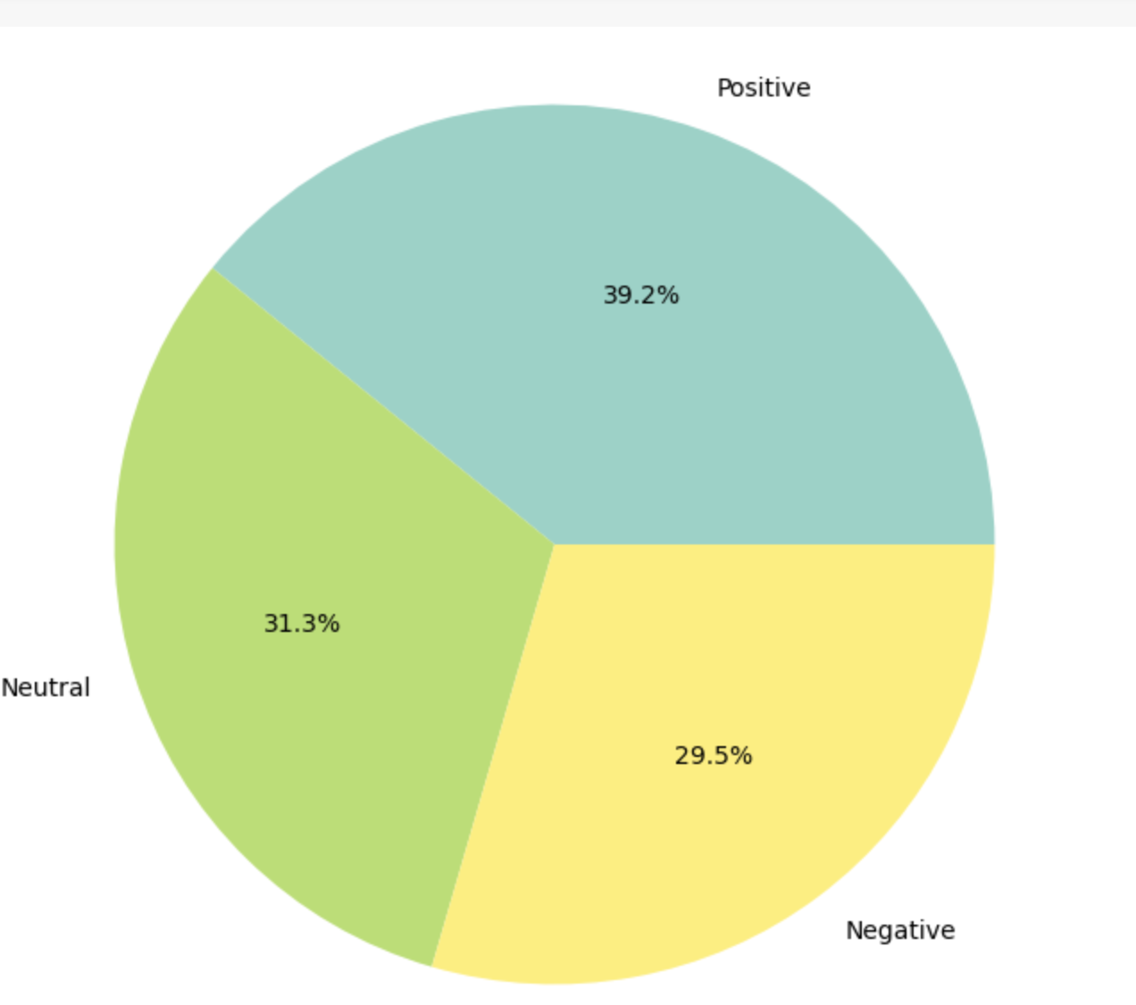
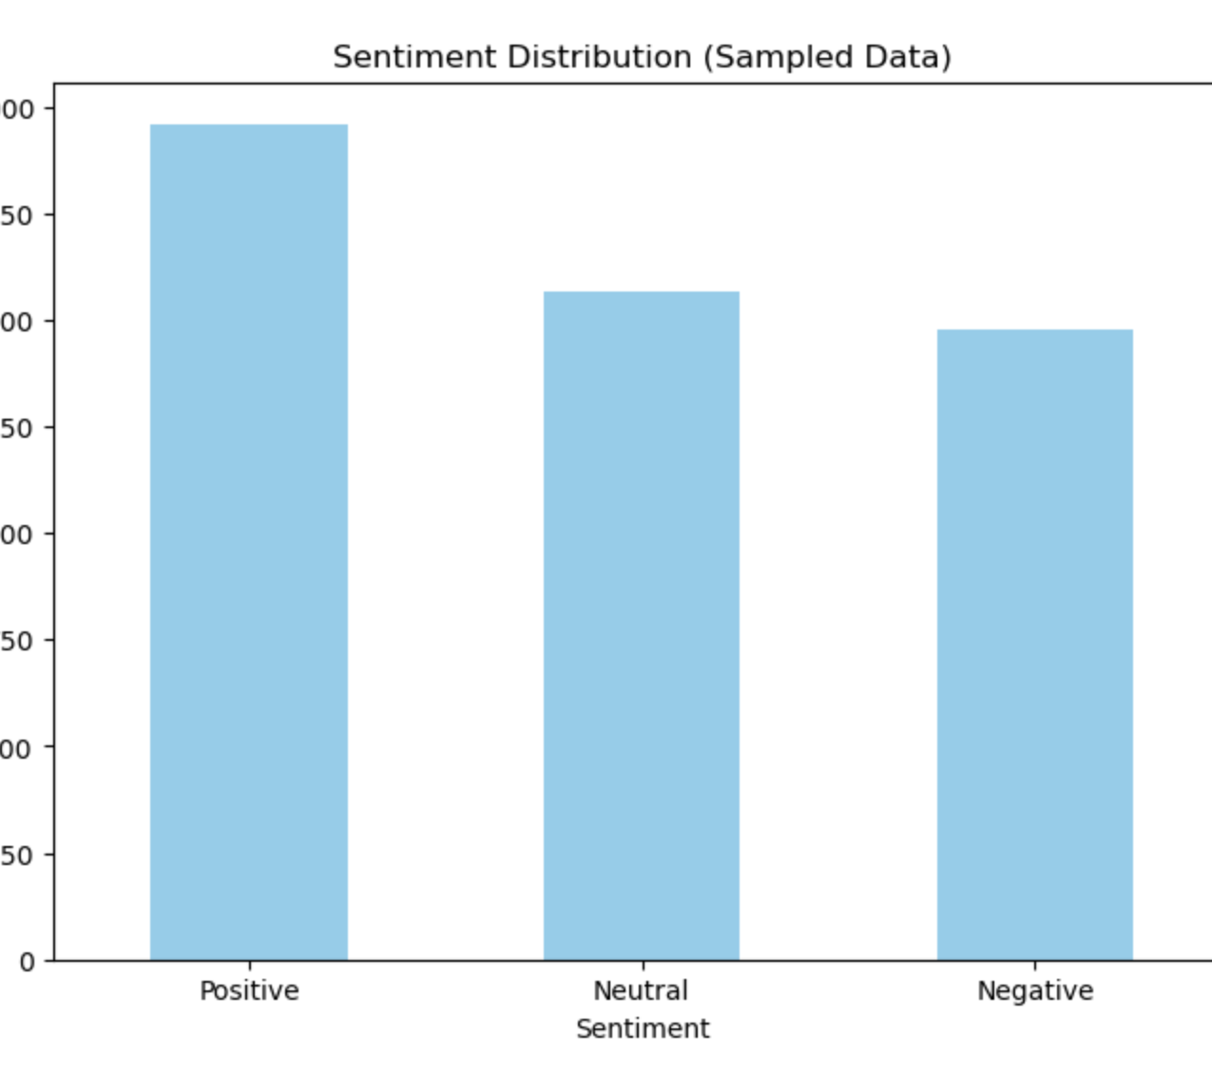
Positive Sentiments:
The highest frequency (approximately 2000), indicating that a significant portion of the sampled data reflects favorable or optimistic sentiments.
Neutral Sentiments:
Slightly less frequent than positive sentiments, showing a moderate number of texts with neutral, factual, or non-opinionated content.
Negative Sentiments:
The least frequent category, but still substantial, indicating a notable amount of dissatisfaction or negative expressions.
Positive Sentiments (39.2%):
The largest portion of the dataset reflects positive emotions or attitudes. This indicates that a significant amount of the text conveys favorable or optimistic sentiments.
Neutral Sentiments (31.3%):
A substantial portion of the data is classified as neutral, implying content that is neither explicitly positive nor negative. These could represent factual or unbiased statements.
Negative Sentiments (29.5%):
A smaller, yet notable, percentage of the text conveys negative sentiments, showing expressions of dissatisfaction, criticism, or unfavorable views.

Slide 8
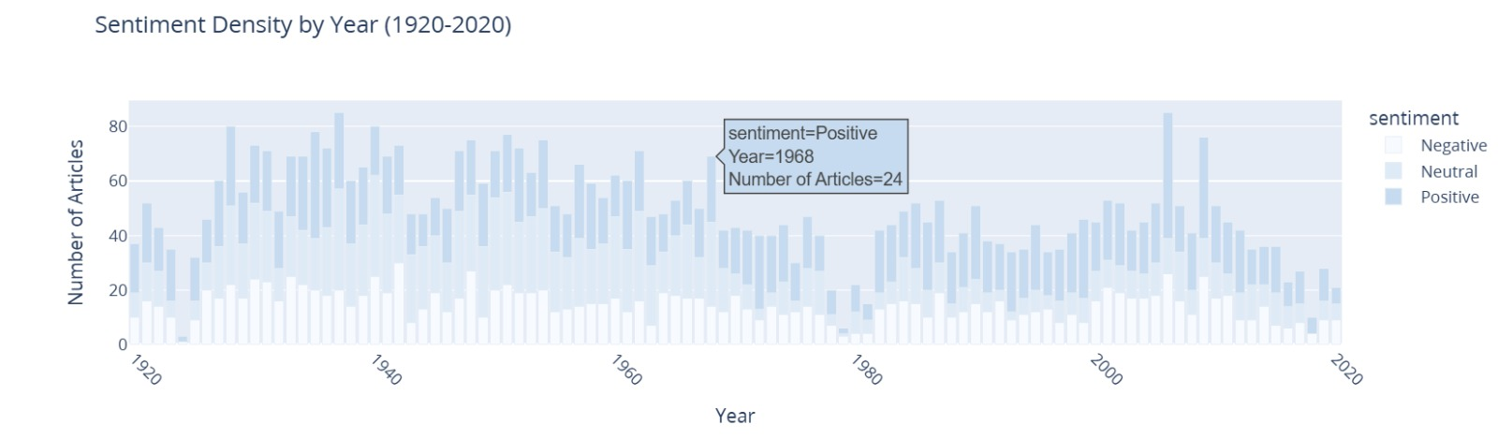
The graph displays sentiment trends (Positive, Neutral, Negative) in articles over the years 1920–2020.
Positive sentiment consistently leads across the timeline.
Sentiment fluctuates, with noticeable spikes in certain years (e.g., 1968).
The density of articles suggests periods of increased or decreased activity in content generation.
Neutral and negative sentiments show varying trends but remain less prominent than positive ones.

Slide 9
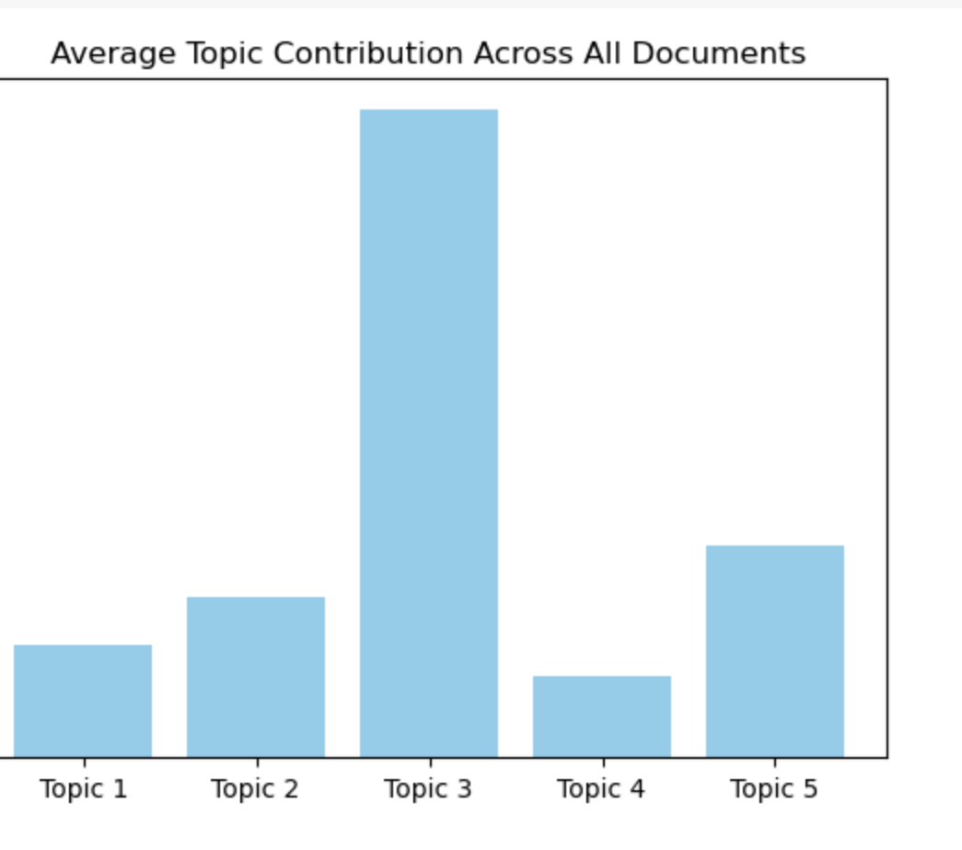
Topic 3:
This is the most dominant topic, with the highest average contribution. It suggests that a large portion of the dataset is strongly aligned with the themes encapsulated by Topic 3.
Topic 5:
Topic 5 shows a moderate average contribution, indicating its themes are significant but less central compared to Topic 3.
Topics 1, 2, and 4:
These topics contribute less on average, with Topic 4 having the lowest contribution. This indicates their themes are less prominent or less frequently discussed in the dataset.

Slide 10
Conclusion
Objective Achieved: Successfully applied topic modeling techniques (LDA, NMF, and BERTopic) to extract meaningful topics from a historical dataset spanning 1920-2020.
Key Insights:
NMF achieved the highest coherence score (0.57), indicating the most interpretable and coherent topics.
BERTopic provided the most granular breakdown with 71 topics but had moderate coherence (0.45).
LDA, while traditional, showed lower coherence (0.39) and struggled with interpretability.
Recommendation: For structured and interpretable results, NMF is the most effective model for this dataset.

Slide 11
Future Work
Enhanced temporal granularity (e.g., monthly data).
Dynamic topic modeling for time-evolving trends.
Sentiment intensity analysis beyond simple classification.
Cross-correlation analysis with external factors.
Development of interactive dashboards.
Comparative analysis across media sources.
Predictive models for future topic trends and sentiment shifts.

Slide 12
Acknowledgements
Data Providers: New York Times dataset.
Open-source community for Python libraries (pandas, matplotlib, gensim, VADER).
Research team for feedback and support.

Slide 13
References
Blei, D. M., Ng, A. Y., & Jordan, M. I. (2003). Latent Dirichlet Allocation. Journal of Machine Learning Research, 3, 993-1022.
Bird, S., Klein, E., & Loper, E. (2009). Natural Language Processing with Python. O'Reilly Media.
Řehůřek, R., & Sojka, P. (2010). Software Framework for Topic Modelling with Large Corpora. Proceedings of the LREC 2010 Workshop on New Challenges for NLP Frameworks.
Hutto, C.J., & Gilbert, E. (2014). VADER: A Parsimonious Rule-based Model for Sentiment Analysis of Social Media Text. Eighth International Conference on Weblogs and Social Media (ICWSM-14).
McKinney, W. (2010). Data Structures for Statistical Computing in Python. Proceedings of the 9th Python in Science Conference.
Hunter, J. D. (2007). Matplotlib: A 2D Graphics Environment. Computing in Science & Engineering, 9(3), 90-95.
Blei, D. M., & Lafferty, J. D. (2006). Dynamic Topic Models. Proceedings of the 23rd International Conference on Machine Learning.
Liu, B. (2012). Sentiment Analysis and Opinion Mining. Synthesis Lectures on Human Language Technologies, 5(1), 1-167.

Slide 14
THANKYOU!

